Slide 1



PROJECT
QSMP
INSTRUCCIONS FOR THE REDDIT

Slide 2
If you have questions on how to create an account to participante on reddit

Slide 3
entry link to the application
https://www.reddit.com/
First step enter in the link

Slide 4
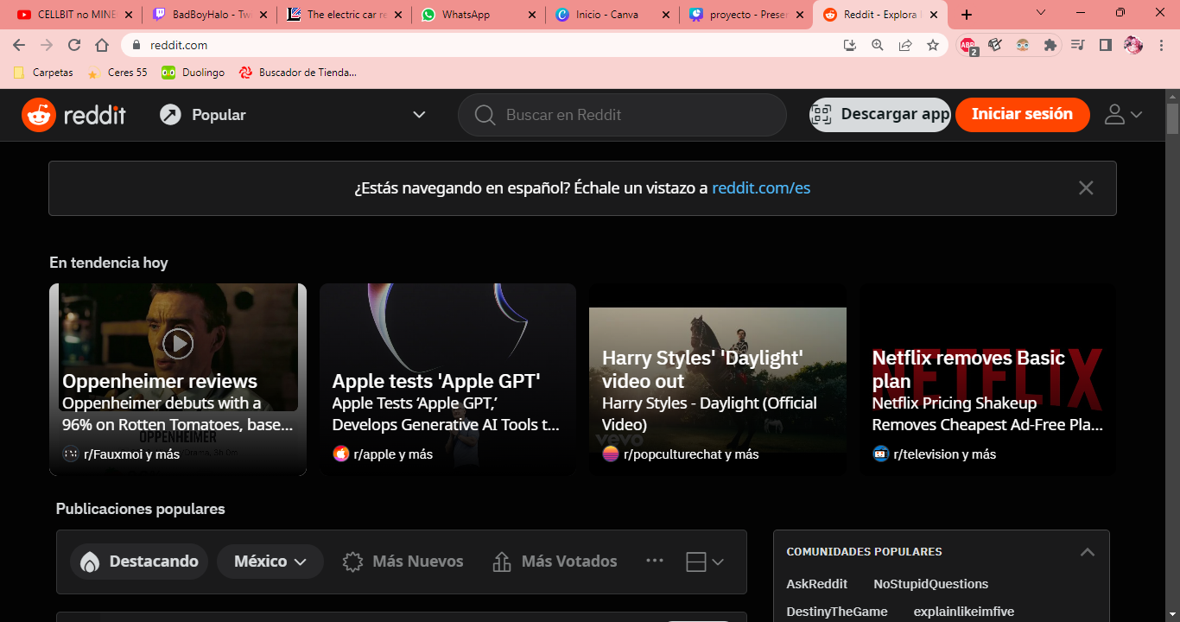
You have to press the boton that says Loggin

Slide 5

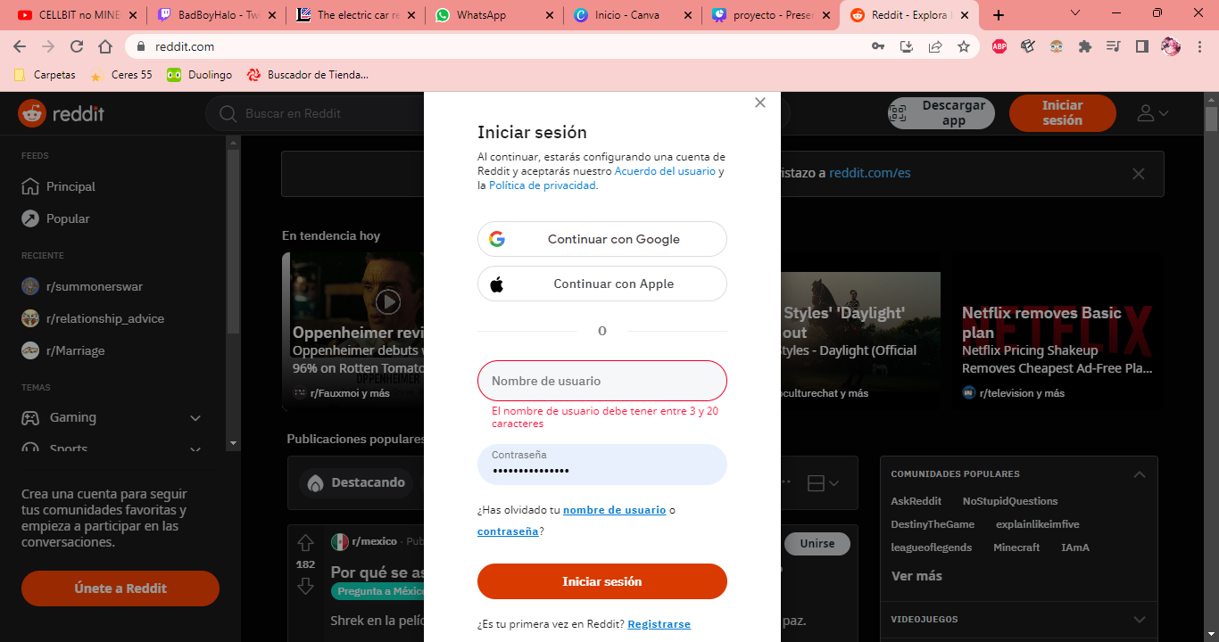
LOGGIN
02

Slide 6

04
¿what proceeds once you do your account?

Slide 7

On july 20
It will be carried out the pixel war. What is the pixel war. Is an event where you can create a pixel art..QSMP and the streamers plan to participate creating pixel art, In the case of QSMP IT WILL BE THE LOGO
06

Slide 8


¿HOW CAN YOU HELP?
08
On july 20, open your account of reddit. In the top of your screen will apear a box. There will give you the chance to put a pixel with color, the range of color that you will se its very simular to paint

Slide 9
Clarifications
You can put 1 pixel each minute of any color you want.
We opened a discord where are we dividing into groups and we are organizing to make the things in the best way possible.
You can put your grain of sand in your free time, the groups will be during all the event.

